Slide 1


Turning the tables on times tables
A handbook of practical strategies

Slide 2


Meet the Maths team:
Nicola Clarke – Gipsey Bridge Academy
Sam Jones – Spalding Primary Academy
Charlotte Tuplin – Spilsby Primary Academy
Tom Bell - St Nicholas CofE primary academy
Susan Ferguson – St Thomas’ CofE Primary
Academy
Lisa Gordon – Pinchbeck East CofE Academy
Joe Hawkins – Wyberton Primary Academy

Slide 3
What does the research say?
-Memorisation versus automaticity-
A recent report from the Organisation for Economic Cooperation and Development (2019) draws upon PISA research to demonstrate that of all the OECD Countries, the UK appears to have the highest use of memorisation, rehearsal and repetition key learning strategies. In her research, Parker cites that colleagues she undertook her project with were wary about an emphasis on ‘rote learning and rapid recall over understanding of mathematical structures.’
The stated purpose of the Multiplication Tables Check (MTC) is to determine ‘whether Year 4 pupils can fluently recall their multiplication tables,’ but it is important to remember that the NC clearly states that ‘fluency and conceptual understanding are developed in tandem because each support the development of the other’. In 2014, Jane Jones, then HMI National Lead for Mathematics, said in an NCETM blog... ‘fluency (that blend of conceptual understanding and procedural flexibility)… capture(s) the best in mathematics education that we would surely want for any pupil.’

Slide 4
With this in mind, when we are talking about balancing the remembering of facts with the notion of developing a conceptual understanding, perhaps we need to consider ‘automaticity’ instead.
Fosnot and Dolk (2001:85) describe the difference here: ‘Memorisation of basic facts usually refers to committing the result of operations to memory so thinking is unnecessary…Teaching facts for automaticity in contrast relies on thinking. Answers to the facts must be automatic, but thinking about the relationships among the facts is critical. A child can then think of 9x6 as (10x6)-6.’
Therefore for us at Infinity, we need to ensure that we are teaching times tables, not just testing children on their rapid recall. We need our children to have the opportunity to explore the relationships and patterns between numbers and facts so that they can apply what they know to what they don’t know.

Slide 5
Times tables in the early years
Mathematics
ELG: Number
Children at the expected level of development will:
- Have a deep understanding of number to 10, including the composition of each number;
14
- Subitise (recognise quantities without counting) up to 5;
- Automatically recall (without reference to rhymes, counting or other aids) number bonds up to 5 (including subtraction facts) and some number bonds to 10, including double facts.
ELG: Numerical Patterns
Children at the expected level of development will:
- Verbally count beyond 20, recognising the pattern of the counting system;
- Compare quantities up to 10 in different contexts, recognising when one quantity is greater than, less than or the same as the other quantity;
- Explore and represent patterns within numbers up to 10, including evens and odds, double facts and how quantities can be distributed equally.

Slide 6
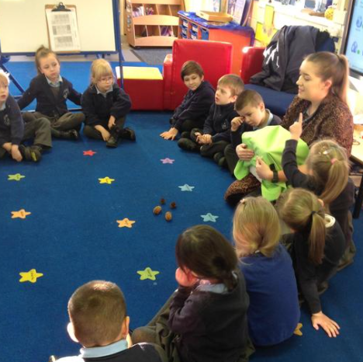
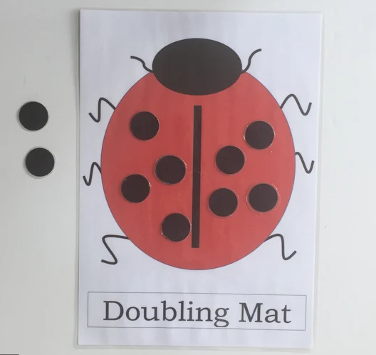
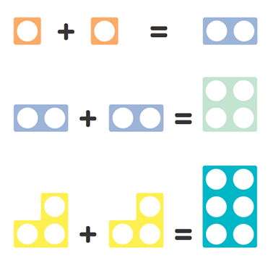
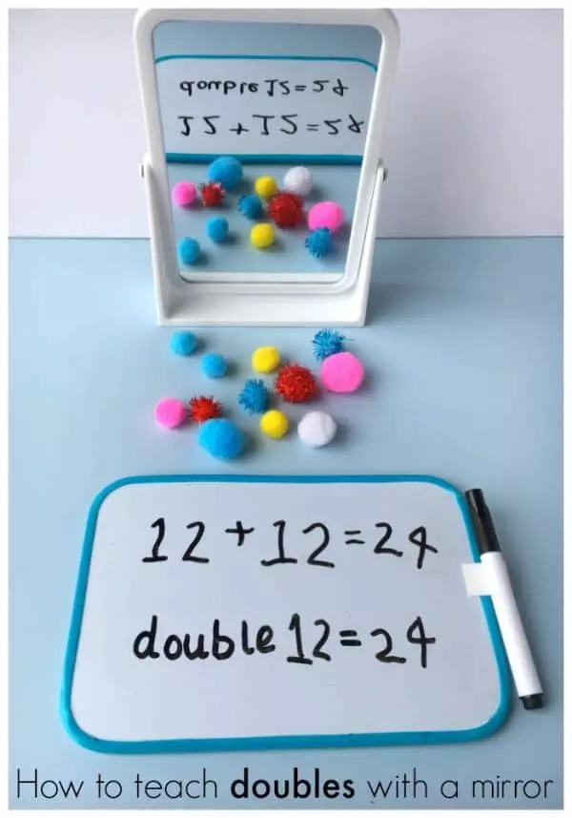
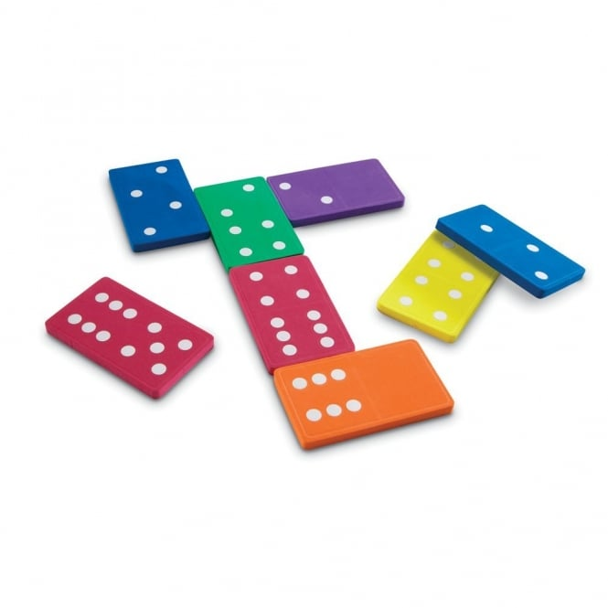
Songs
Numicon
Dominoes

Slide 7
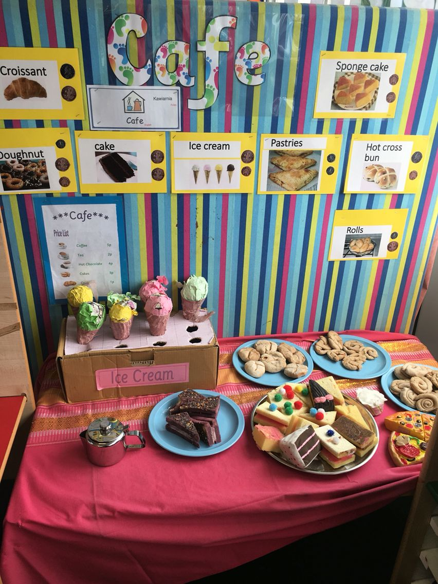
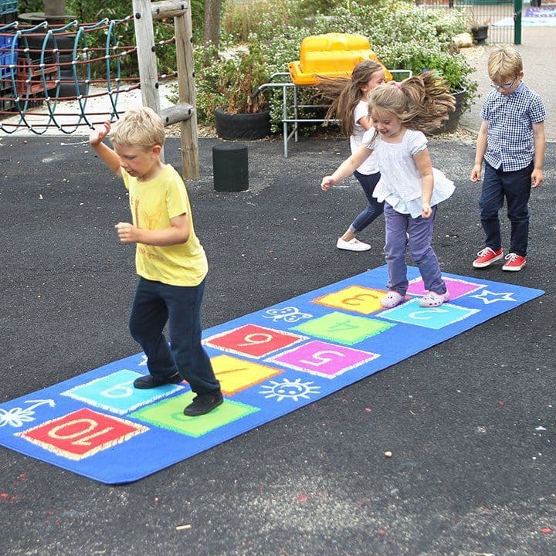
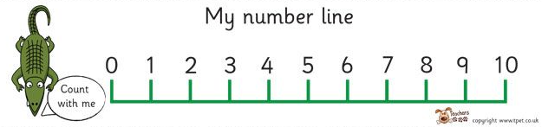
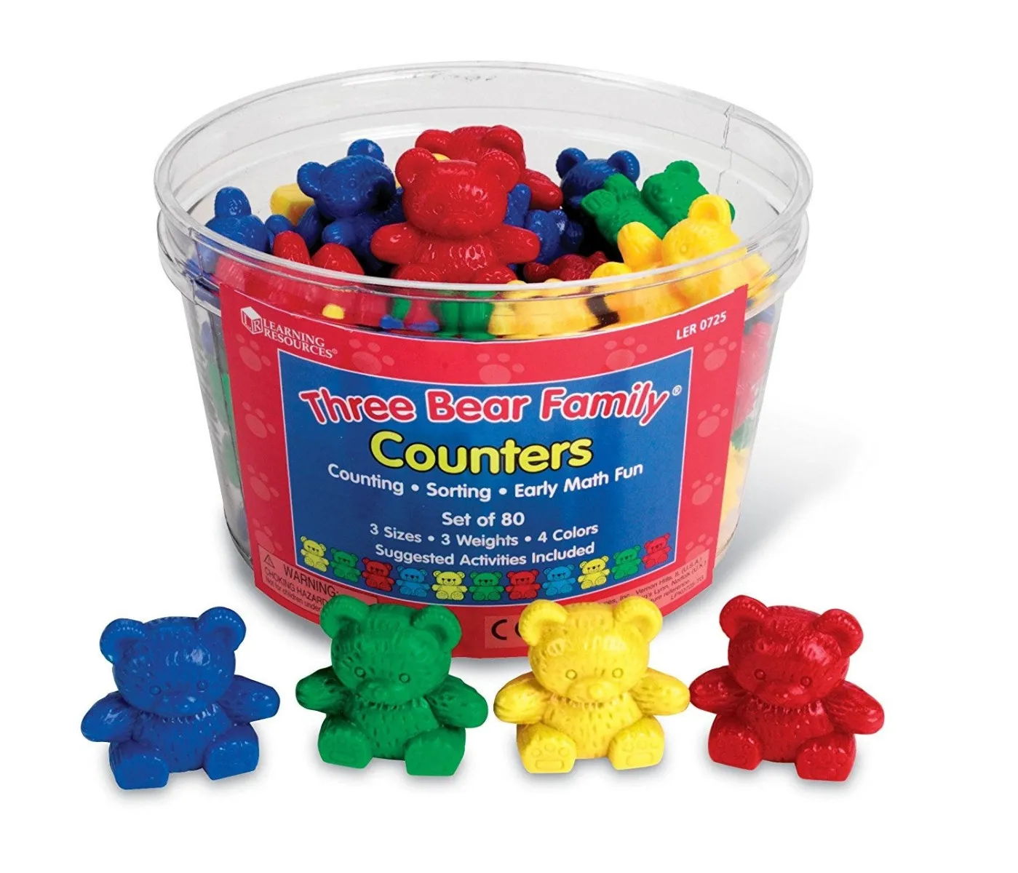
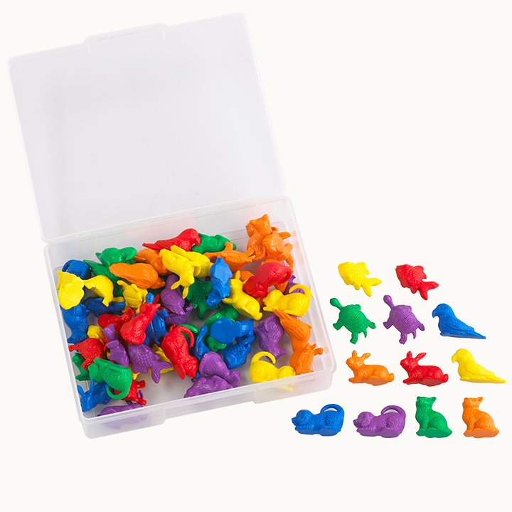
Number lines
Use of the Outdoors
Hopscotch
Provision
Role Play to embed skills
H.O.P.E
Have a go
Over and over
Prove it
Explain it
Variety of concrete equipment.

Slide 8
Times tables in Key Stage 1
Year 1 programme of study
Number - number and place value
Pupils should be taught to:
count, read and write numbers to 100 in numerals; count in multiples of 2s, 5s and 10s
Number - multiplication and division - Notes and guidance (non-statutory)
They make connections between arrays, number patterns, and counting in 2s, 5s and 10s.
Number - fractions
Pupils should be taught to:
recognise, find and name a half as 1 of 2 equal parts of an object, shape or quantity
recognise, find and name a quarter as 1 of 4 equal parts of an object, shape or quantity
Measurement
Pupils should be taught to:
compare, describe and solve practical problems for:
  lengths and heights [for example, long/short, longer/shorter, tall/short, double/half]

Slide 9
Year 2 programme of study
Number - number and place value
Pupils should be taught to:
count in steps of 2, 3, and 5 from 0, and in 10s from any number, forward and backward
Number - multiplication and division
Pupils should be taught to:
recall and use multiplication and division facts for the 2, 5 and 10 multiplication tables, including recognising odd and even numbers
calculate mathematical statements for multiplication and division within the multiplication tables and write them using the multiplication (×), division (÷) and equals (=) signs
show that multiplication of 2 numbers can be done in any order (commutative) and division of 1 number by another cannot
solve problems involving multiplication and division, using materials, arrays, repeated addition, mental methods, and multiplication and division facts, including problems in contexts

Slide 10
Notes and guidance (non-statutory)
Pupils use a variety of language to describe multiplication and division.
Pupils are introduced to the multiplication tables. They practise to become fluent in the 2, 5 and 10 multiplication tables and connect them to each other. They connect the 10 multiplication table to place value, and the 5 multiplication table to the divisions on the clock face. They begin to use other multiplication tables and recall multiplication facts, including using related division facts to perform written and mental calculations.

Slide 11
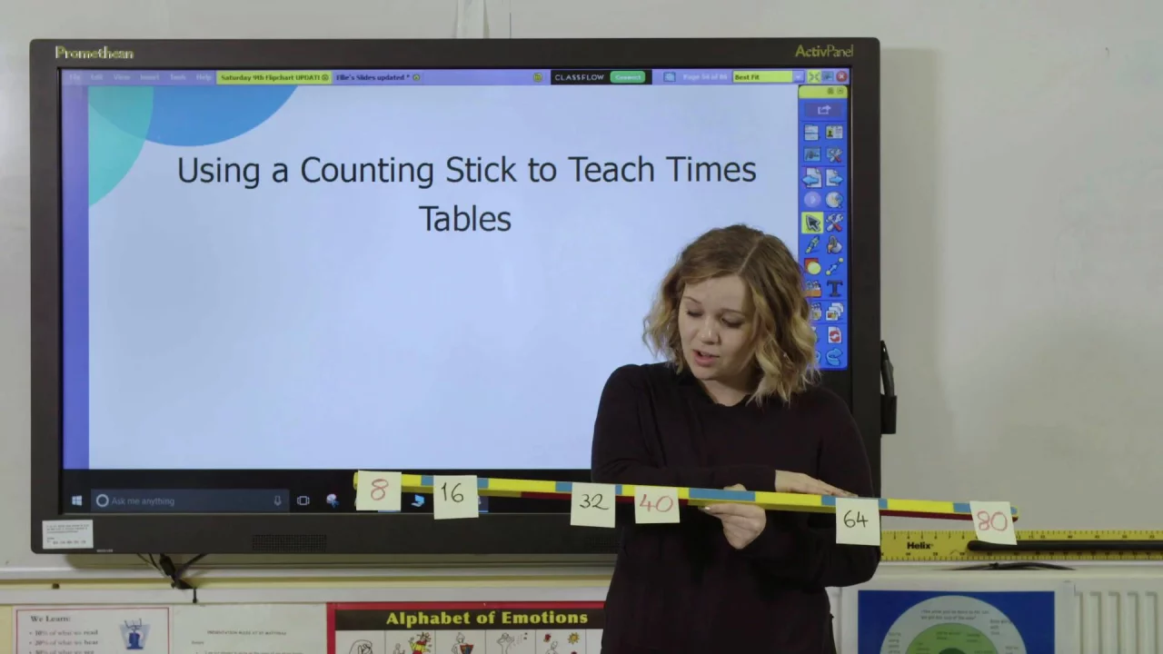
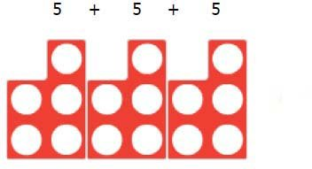
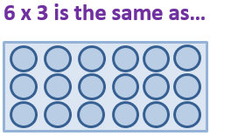
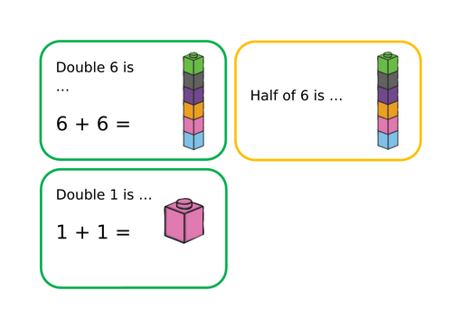

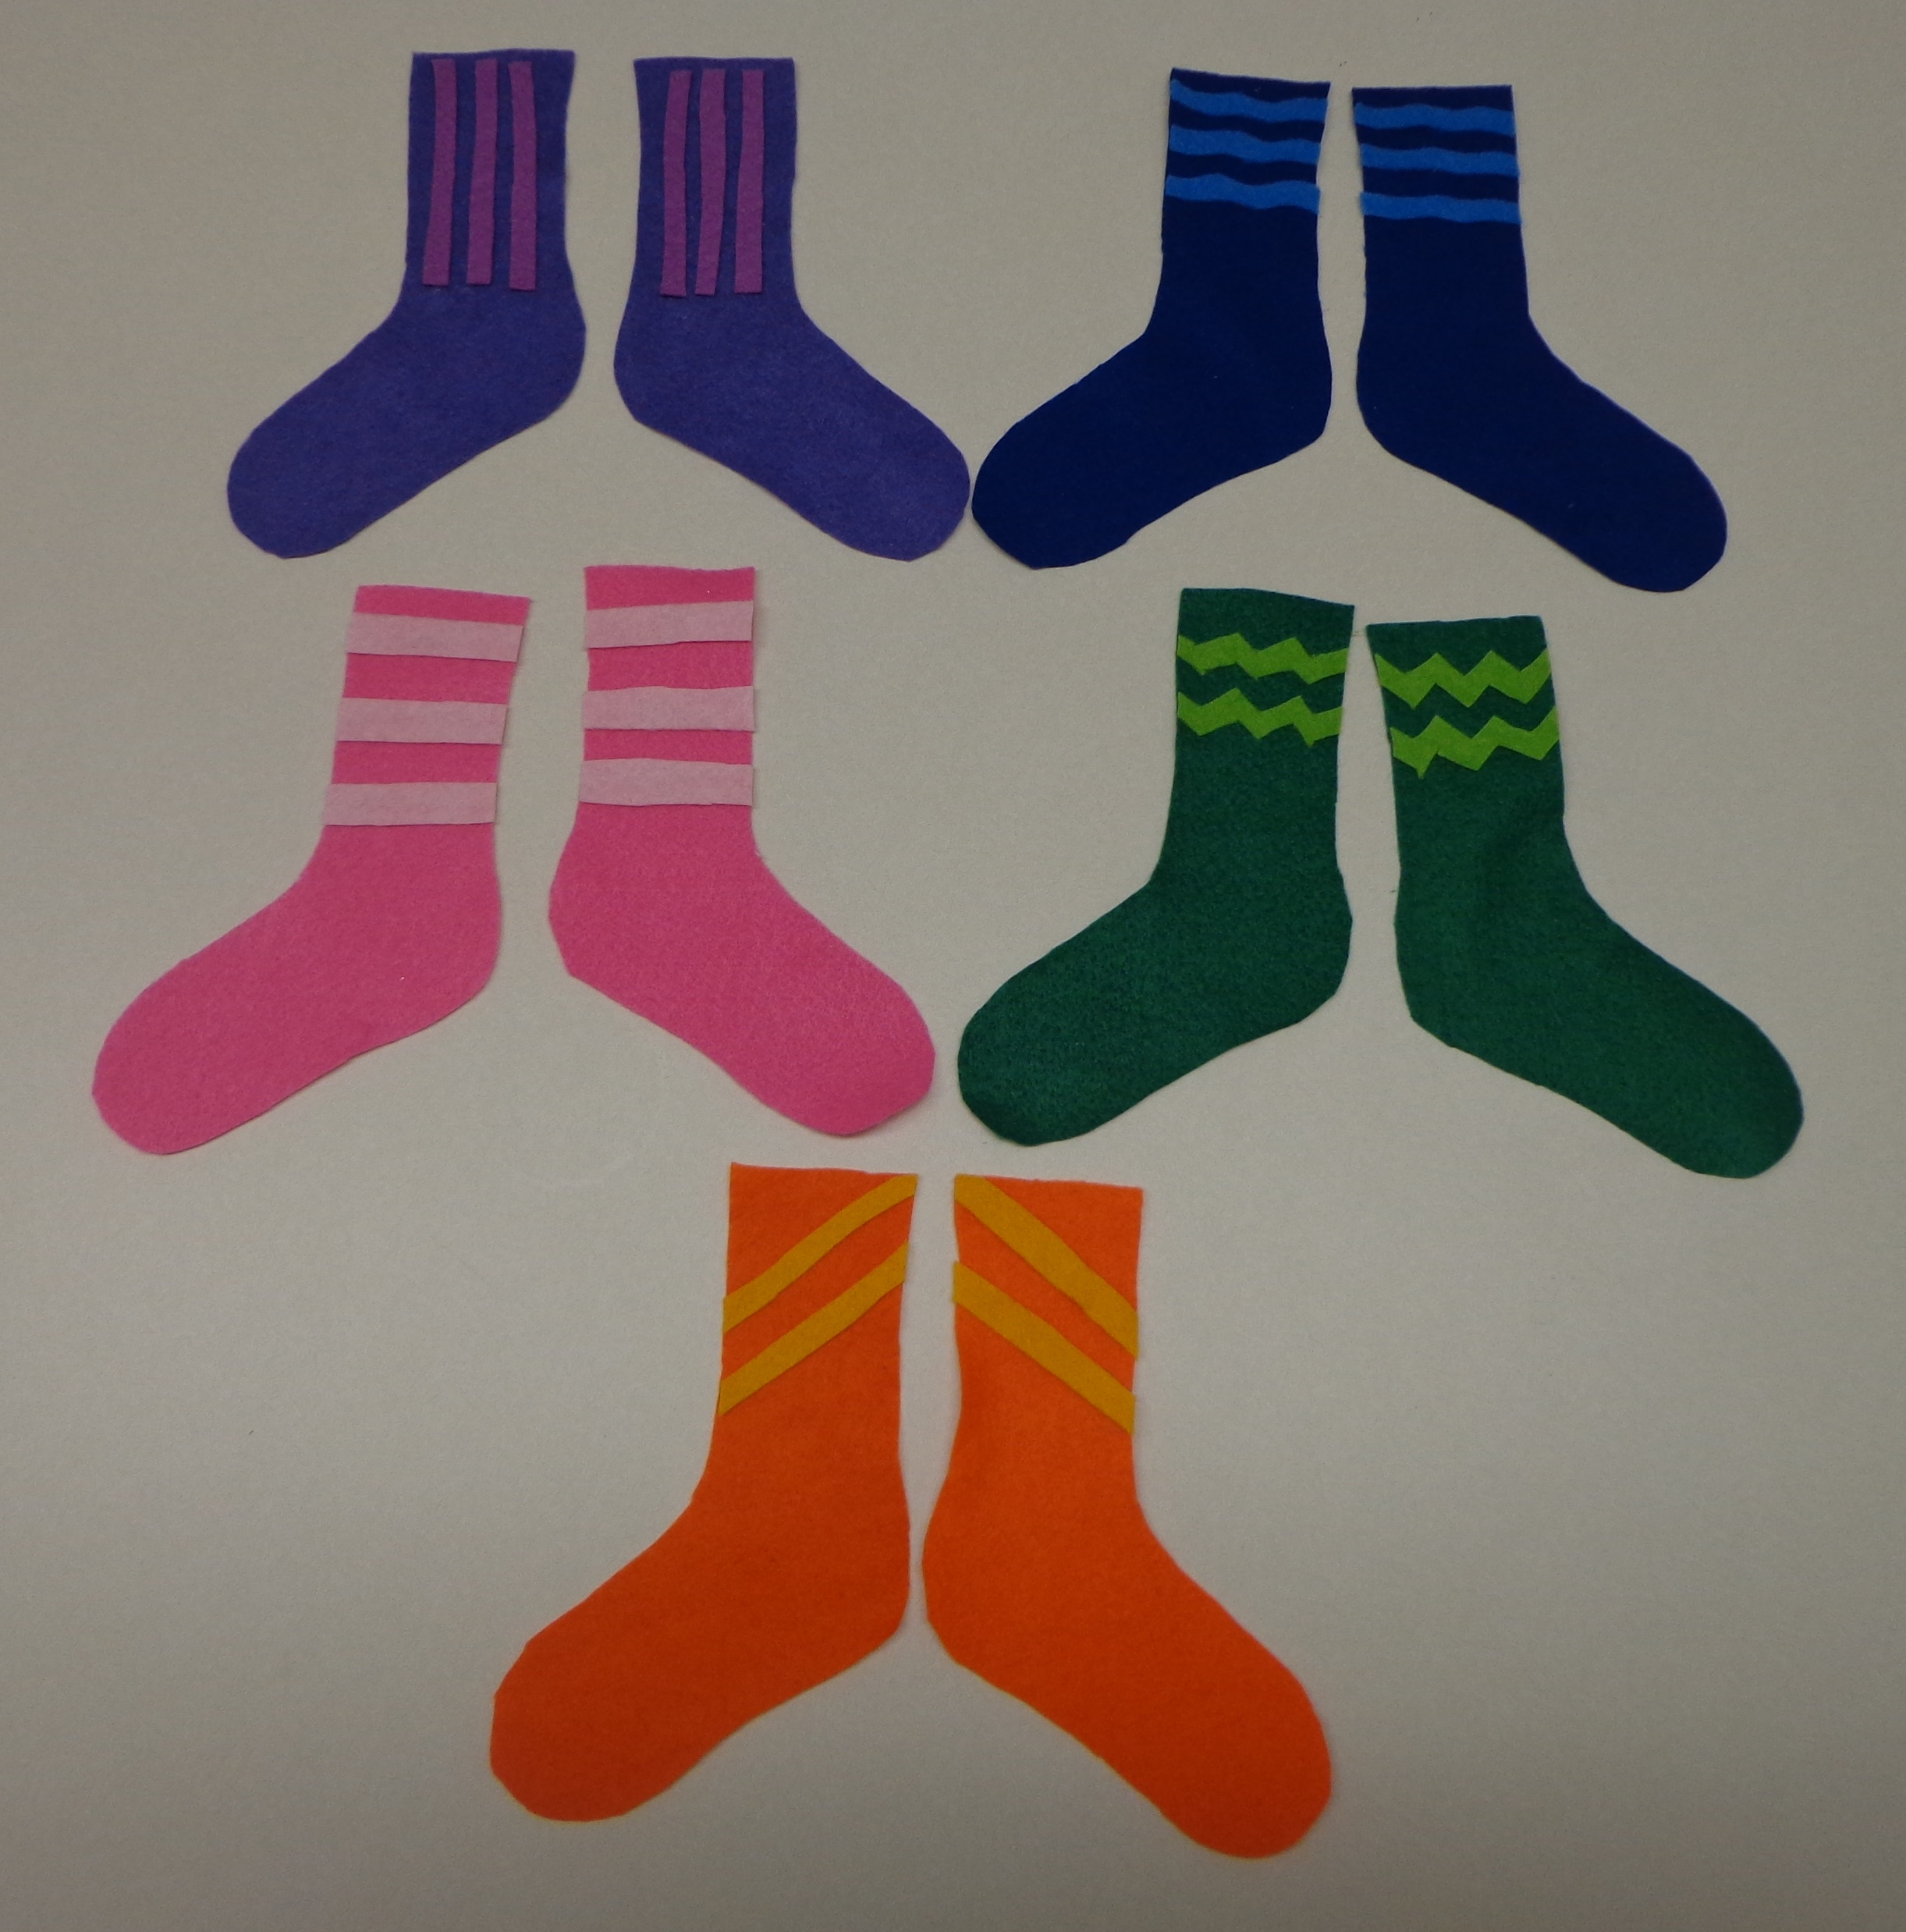
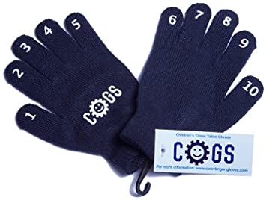
Arrays
Matching calculation with an array.
Explore commutative
Numicon
Repeated addition
https://youtu.be/yXdHGBfoqfw
https://www.bbc.co.uk/teach/supermovers
Cubes
Doubling/Halving/exploring groups/patterns
Use of visuals

Slide 12

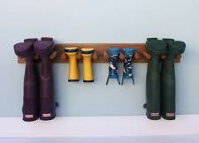
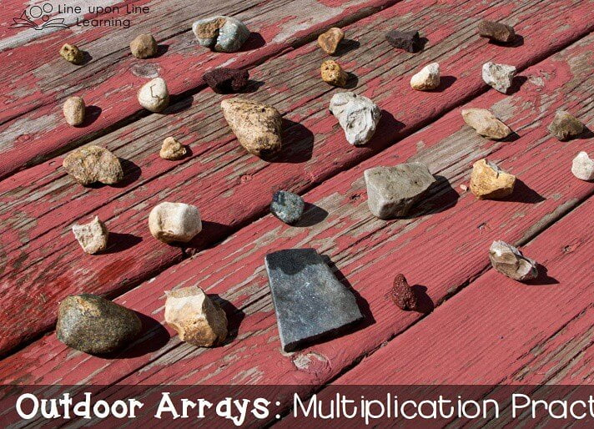

Real Life Context

Slide 13
Times tables in Lower Key Stage 2
Year 3 programme of study
Number – number and place value
count from 0 in multiples of 4, 8, 50 and 100; find 10 or 100 more or less than a given number
Notes and guidance (non-statutory)
Pupils now use multiples of 2, 3, 4, 5, 8, 10, 50 and 100.
Number – multiplication and division
Statutory requirements
Pupils should be taught to:
recall and use multiplication and division facts for the 3, 4 and 8 multiplication tables
Notes and guidance (non-statutory)
Pupils continue to practise their mental recall of multiplication tables when they are calculating mathematical statements in order to improve fluency. Through doubling, they connect the 2, 4 and 8 multiplication tables.
Pupils develop efficient mental methods, for example, using commutativity and associativity (for example, 4 × 12 × 5 = 4 × 5 × 12 = 20 × 12 = 240) and multiplication and division facts (for example, using 3 × 2 = 6, 6 ÷ 3 = 2 and 2 = 6 ÷ 3) to derive related facts (for example, 30 × 2 = 60, 60 ÷ 3 = 20 and 20 = 60 ÷ 3).

Slide 14
Year 4 programme of study
Number – number and place value
Statutory requirements
Pupils should be taught to
count in multiples of 6, 7, 9, 25 and 1000
Number – multiplication and division
Statutory requirements
Pupils should be taught to:
▪ recall multiplication and division facts for multiplication tables up to 12 × 12
▪ use place value, known and derived facts to multiply and divide mentally, including: multiplying by 0 and 1; dividing by 1; multiplying together three numbers
▪ recognise and use factor pairs and commutativity in mental calculations
Notes and guidance (non-statutory)
Pupils continue to practise recalling and using multiplication tables and related division facts to aid fluency.

Slide 15
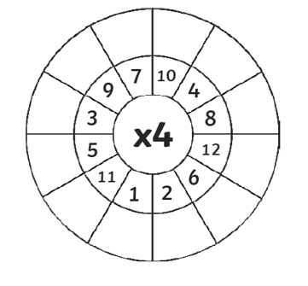
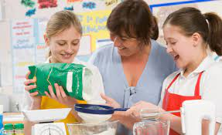
https://youtu.be/yXdHGBfoqfw
Multiplication Wheels
Arrays
Matching calculation with an array.
Real life opportunities
Cooking – scaling up/down quantities
https://www.bbc.co.uk/teach/supermovers

Slide 16
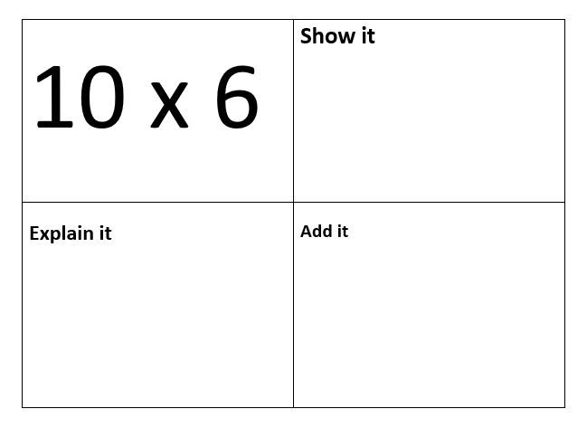
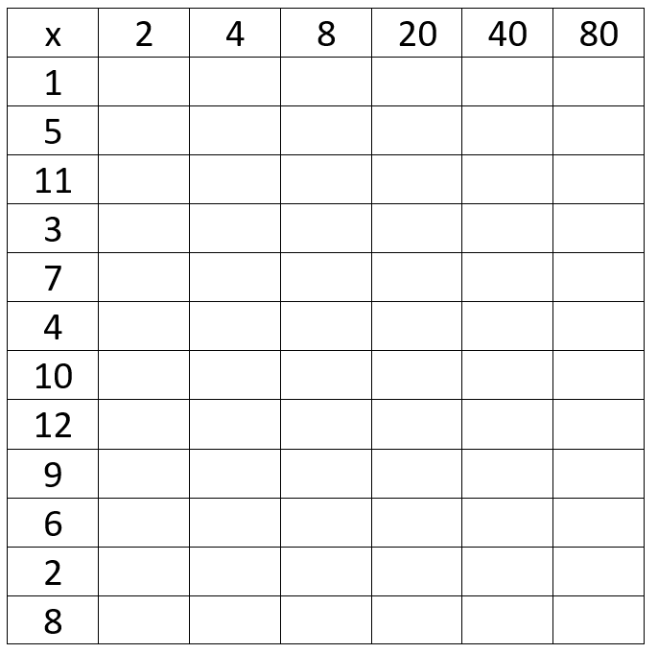
Multiplication Grid

Slide 17
Times Tables in Upper Key Stage 2
Year 5 and 6 programme of study
Multiplication and Division
identify multiples and factors, including finding all factor pairs of a number, and common factors of two numbers
It is then all about the application of the knowledge and skills taught all the way from EYFS to Year 6.

Slide 18
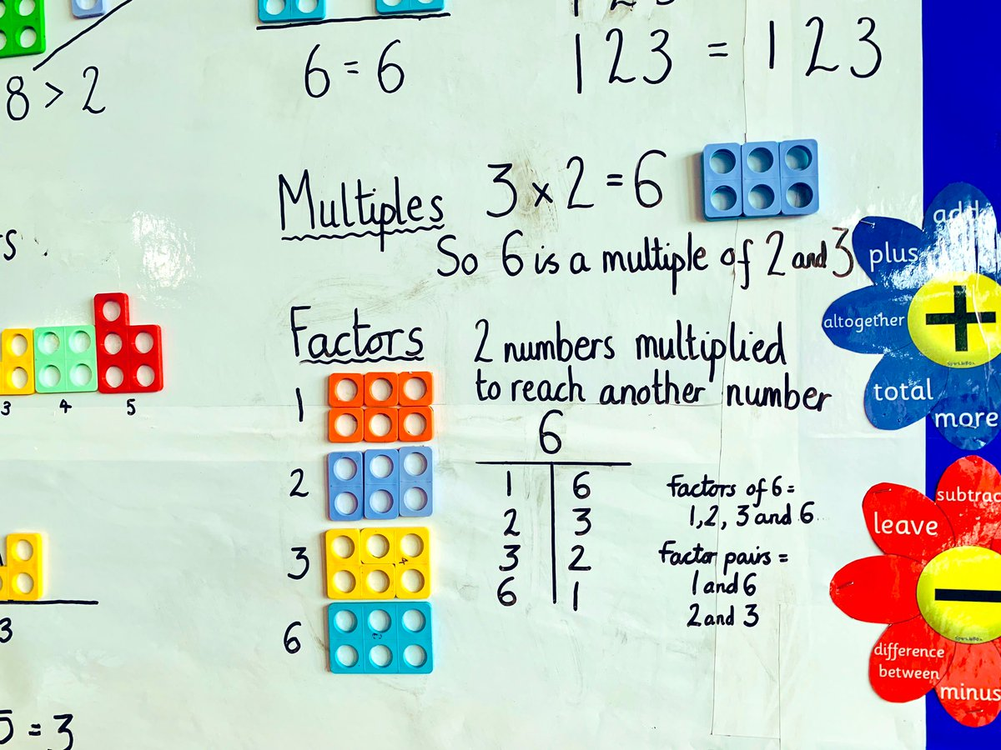
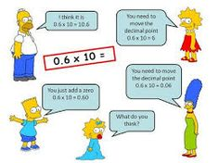
Arrays
Matching calculation with an array.
https://youtu.be/yXdHGBfoqfw
Numicon
Factors and Multiples
Real life opportunities
Cooking – scaling up/down quantities
Concept Cartoons

Slide 19
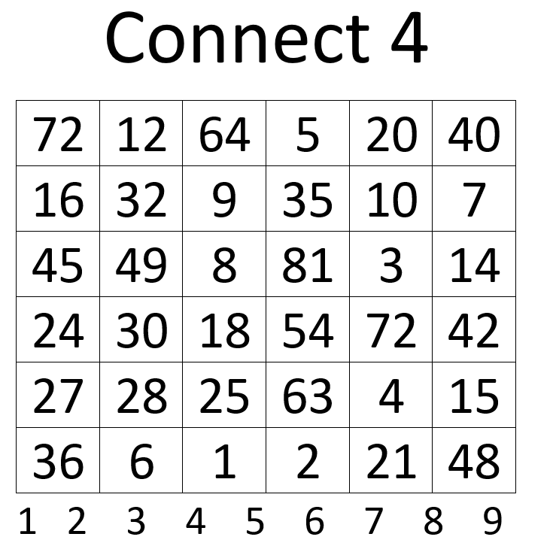
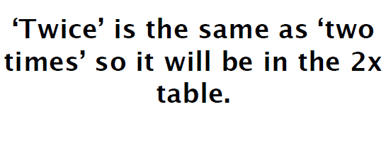
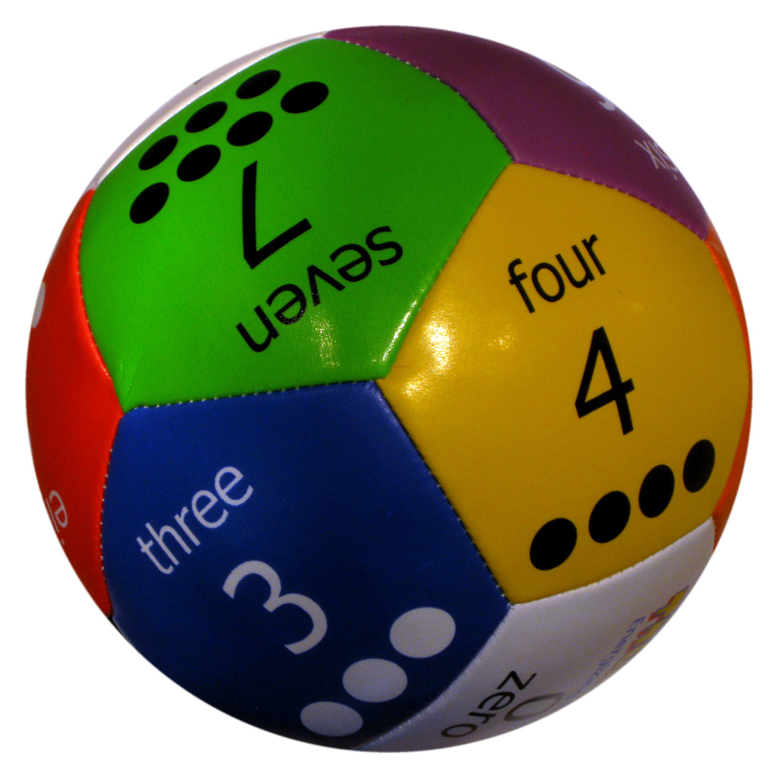
Sometimes, Always, Never
Thumball

Slide 20


Slide 21
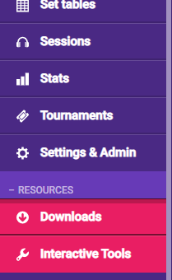

TT Rockstars is a great resources that many of our schools use – but are we using it as effectively as what we could be?
Have you ever had a look at the ‘Downloads’ and ‘Interactive Tools’ parts of TT Rockstars?

Slide 22

Downloads
Information including:
Staff Meeting information – there is a useful Powerpoint that goes through the different things that Rockstars can be used for.
Certificates – these are easily downloadable ready to give to the children.
Display Resources – a wealth of high-quality, colourful materials for use in your classrooms.
Teacher Resources – including an editable tracking grid to map out each child’s progress and identify gaps.
Fact of the Week – a great resource that is progressive and uses different visual representations of facts.
Parent Information – a guide for parents to explain what Rockstars is and how they can support their children. Also available is information for Year 4 parents regarding the Multiplication Tables Check (MTC).

Slide 23
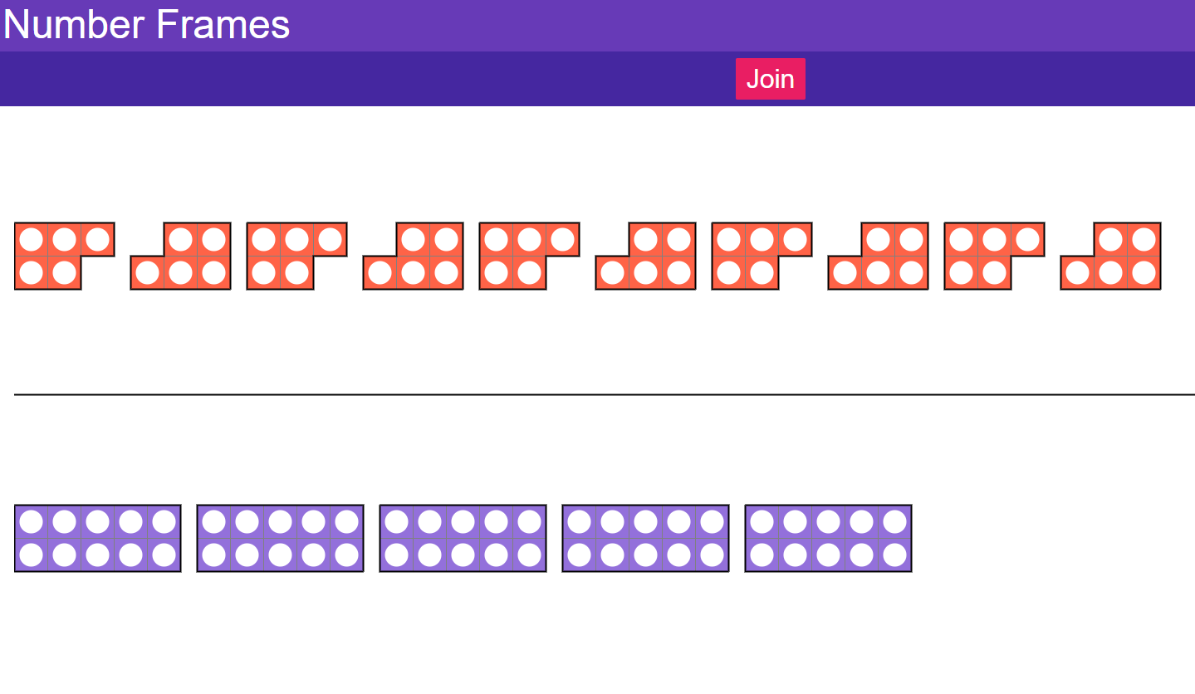
Interactive Tools
You can choose to join the Numicon or keep it separate.
Great for use in lessons where you are exploring variation and representation.

Slide 24
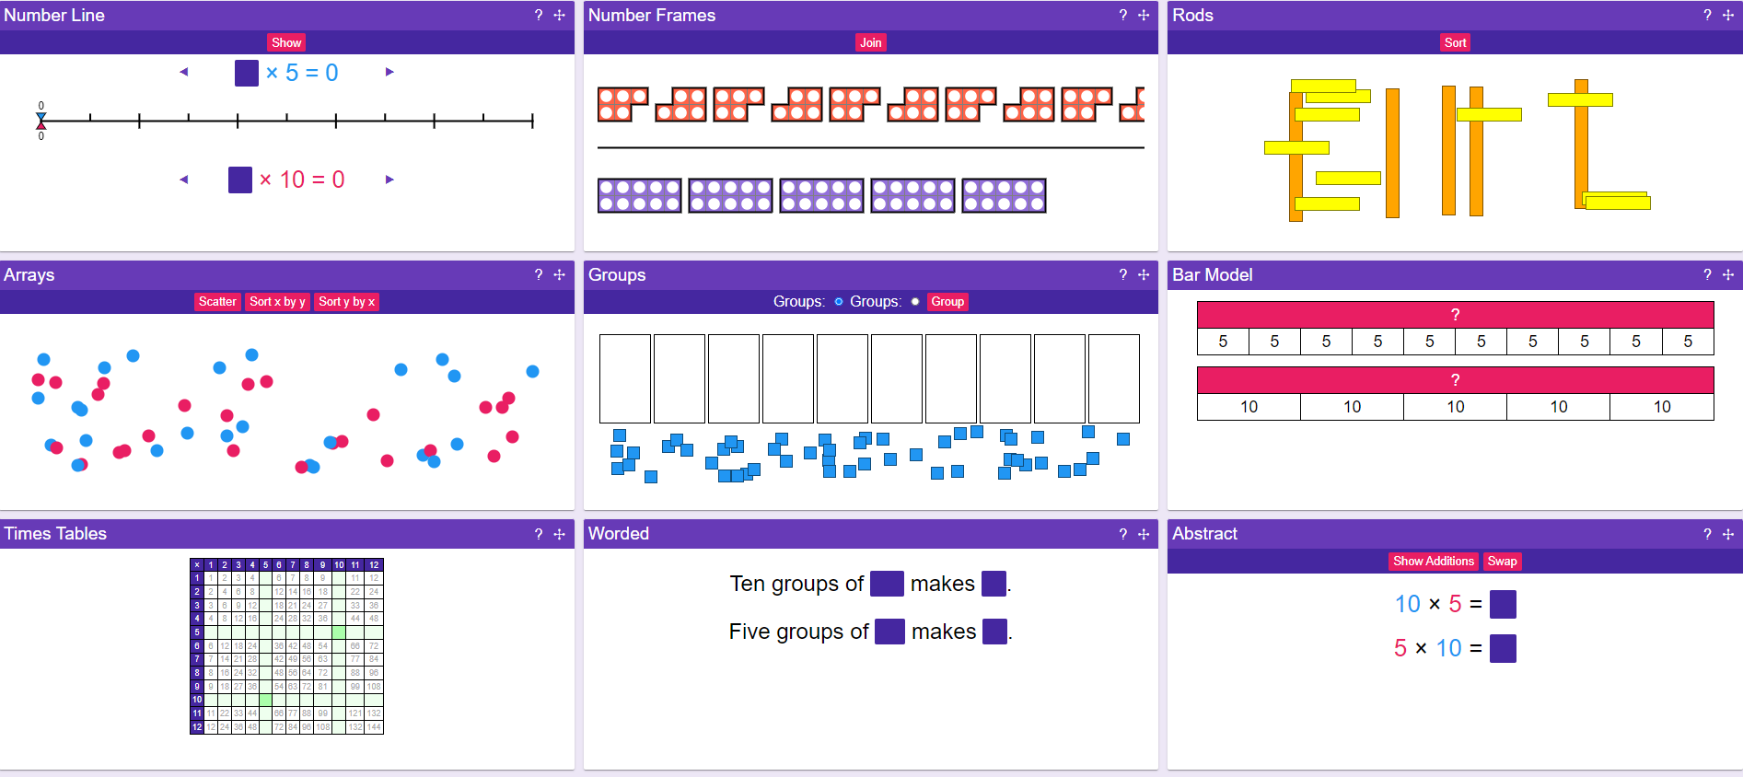
Click on the cross if there is a specific representation you want.

Slide 25
References
Fosnot, C. and Dolk, M. (2001) Young Mathematicians at Work Pearson Education Canada
Jones, J. (2014) NCETM Blog Available at: https://www.ncetm.org.uk/features/guest-blog-by-jane-jones-hmi-ofsted/
Parker, G. (2019) Teaching multiplication tables Primary Mathematics Vol 23 Issue 1 pp3-6

