Slide 1

The Teaching of Reading
A handbook of practical strategies

Slide 2


Meet the Reading team:
Rosheene Drury– Gipsey Bridge Academy
Sian Thornton/ Laura Croft – Spalding Primary Academy
Kate Taylor– Spilsby Primary Academy
Lynne Smith- St Nicholas CofE Primary Academy
Alison Smith– St Thomas’ CE Primary Academy
Chloe Pentney– Pinchbeck East CofE Academy
Melissa Anstey– Wyberton Primary Academy
Sarah Marsden– Little Gonerby Infant Academy

Slide 3

What does the Reading Framework say?

Slide 4



Summary of the DfE’s Reading Framework
THE IMPORTANCE OF TALK Young children typically gain several new words a day, acquiring vocabulary at an ‘astonishing rate’. Yet by the time they start school, some children will have heard millions more words than others. The number of words a child has heard and can speak by the age of three is a predictor of later language development, so these early vocabulary gains are critically important. A language-rich environment is one in which adults talk with children throughout the day. The more children take part in conversations, the more they will understand once they can read and the more vocabulary and ideas they will have to draw on when they can write. Spoken language runs through the national curriculum programmes of study for English and all seven areas of learning and development in the revised Early Years Foundation Stage statutory framework.
READING IS A CATYLIST Reading for pleasure is associated with higher levels of literacy achievement. There is also a relationship between cognition and motivation, proficiency, and motivation in reading. Those who are good at reading do more of it: they learn more and expand their vocabulary and knowledge. This enables them to understand more of what they read. For those who read less, or who find reading difficult, the opposite is true. Reading more makes children more academically able.

Slide 5



VOCABULARY ACQUISITION THROUGH TALK High-quality adult interactions and purposeful experiences can build children’s vocabulary size. The report provides an example of how a visit to a fire station might unleash the teaching of semantic fields linked with some key information. For example, by talking of fire, pupils would learn and connect words such as blaze, flames, heat, smoke, plumes and extinguish. This supports later reading by helping children comprehend texts when they see such words.
ADULTS MODELLING SPEAKING AND LISTENING Adults can plan to develop children’s vocabulary through everyday experiences. This can include adding adjectives and an adverb into interactions so that children begin to expand their word knowledge and understand them in a greater range of contexts. Children should also be explicitly taught what good listening looks like, both through direct instruction and through teacher modelling. Good listening should also, of course, be reinforced and rewarded with praise.
PARTNER TALK Children benefit from being taught how to talk to a partner, speaking in complete sentences and taking turns as appropriate. Children should be taught to speak to each other in sentences and to listen to each other’s ideas. Teachers can use these interactions to assess what children know, as they listen in to their discussions and give feedback. Pairs can then be selected to share their responses with the group.

Slide 6



NO HANDS UP The practice of asking for children to raise their hands to share ideas can reduce the opportunities for interaction. It can limit the number of children who a teacher ‘hears’, exclude children who raise their hand and aren’t heard, and suggest to children who don’t raise their hands, that they don’t need to participate. Over time, the difference between interactions of those who raise their hands and those who don’t, increases the language gap that we want to eliminate.
CHOOSING BOOKS TO READ ALOUD Teachers should choose books which engage children emotionally. Young children care about what their teachers think about the stories they read aloud. The report gives a guide of how to choose books to ensure children are presented with a wide range of stories from a wide range of contexts. There should be a ‘core’ set of stories for each year group which reflects a wide range of backgrounds and contexts, which can be supplemented by teacher choice.
THRIVING ON REPETITION By re-reading stories to children, teachers can deepen the children’s familiarity with a story and increase their emotional engagement. Re-reading allows children to hear new vocabulary over again, which helps them commit the meaning of new words into their long-term memory. Additionally, children have new opportunities to connect with characters and their feelings, and to relive the excitement and emotion of stories.

Slide 7


DEDICATED TIME FOR STORIES, POEMS AND RYMES There should be a dedicated story time each day as well as a dedicated poetry or singing time in Reception and Year 1. This should be a priority. Extra-small group story times can be used as additional inputs for children with speech, language and communication needs. Schools should encourage parents to read aloud to their children and to provide opportunities for children to read at home.
BOOK CORNERS The books themselves are the most important aspect of any book corner. It should be the words of the stories and not the props that transport children to different worlds: the mysterious forest, the dark and dripping cave, the moated castle. Well-chosen books should capture children’s imagination to such an extent that they become unaware of whether they are sitting on a beanbag, an ordinary classroom chair or a bench in the book corner. Time might therefore be better spent on selecting, displaying and promoting the books in the book corner than on decorating it. Ideally, every book corner should be a mini-library, a place for children to browse the best books, revisit the ones that the teacher has read to them, and borrow books to read or retell at home. Every child should be able to spend time in their book corner. Children will want to share books with others, especially if they are ‘books in common’ that they know their friends have heard before. They will also be interested to look at books which feature well-known fictional characters or are new and tempting.

Slide 8

SYSTEMATIC PHONICS INSTRUCTION Schools should implement a systematic phonics programme. There is not enough space here to capture the full importance of phonics, but it is important to point out that fidelity to a systematic programme, with the implementation monitored by a school’s leadership team is one of the most effective ways of teaching all children how to read and write. Decodable books allow children to practise and memorise their learning from phonics lessons, so that they build their accuracy, fluency and confidence with their phonological knowledge.

Slide 9

Reading Fluency

Slide 10
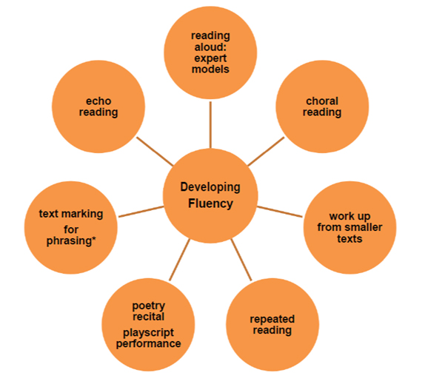

Slide 11

Reading Vocabulary

Slide 12
Dictionary work – choose 3 words from a text (this would work well with non-fiction). Children to be taught how to use a dictionary or a glossary to find the meanings).
Retelling stories – Provide the children with key words from a story to help them in their retelling. Each word could be worth a certain number of ‘points’ based on their difficulty.
Revisiting and retrieving key vocabulary from a previous lesson and making links.
Use of learning walls
Use of visual images alongside words to help with retention.
Picking out key vocabulary when reading aloud and discussing, using in sentences.
Showing children sentences with words missing – what words could go in here. Looking at how words can affect meaning.
Vocabulary 4 square (see next page)
Matching words to definitions
Word families work, including looking at prefixes and suffixes.
Synonym snakes and ladders (see following pages)
Voc-app-ulary (see following pages)

Slide 13
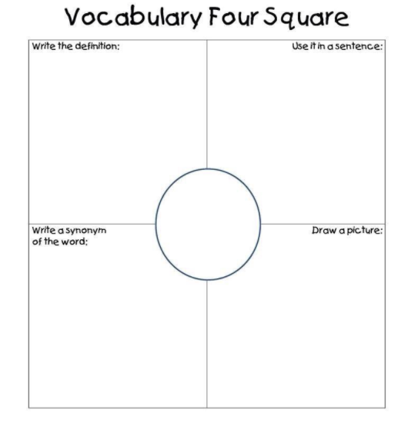

Slide 14
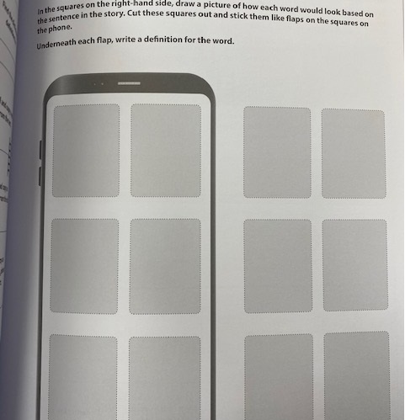
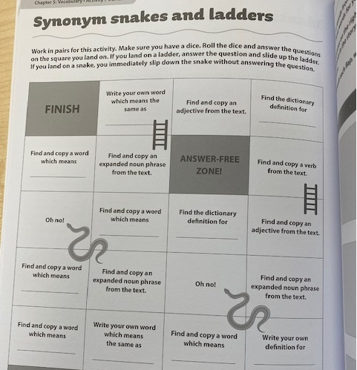

Slide 15
Reading Retrieval

Slide 16
Here are the answers- what are the questions?
‘Find and Copy one word’ style questions.
Keyhole – If I saw this character/scene through a keyhole, what would I see? (draw/paint activity)
Vocab Ninja books – example texts linked to non-core learning.
Explore the language of retrieval – children to ask own retrieval style questions.
Fact dump
(see following pages)
Retrieval pyramid
(see following pages)
Traffic light retrieval (see Following Pages)

Slide 17
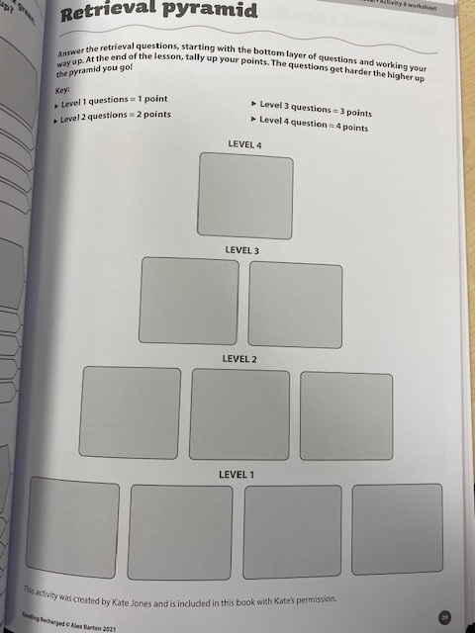
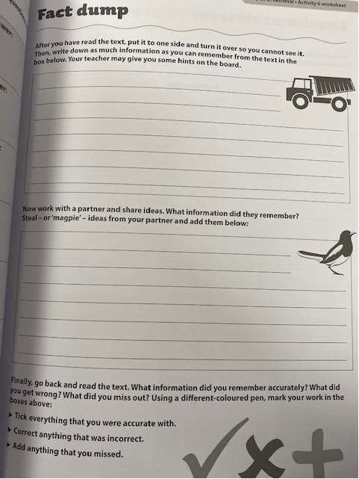

Slide 18
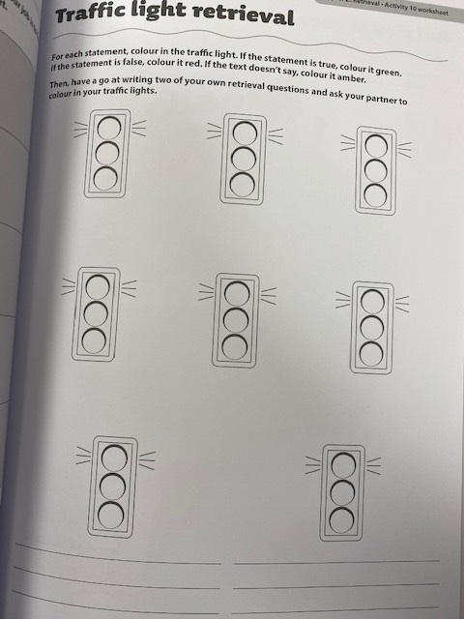

Slide 19
Reading Inference

Slide 20
Use of images and film to develop early inference.
Use of drama to get in to the shoes of a character or a setting/event.
If this character was a superhero, what powers/skills would they have?
Images of characters – match key vocab to show feelings/characteristics etc
PC Prove it – statements on post it notes – prove it is true by finding evidence in the text.
The genie – If you could grant this character three wishes, what would they be?
Piggy Bank – children to think about what a character would choose to buy with money in a piggy bank.
Emotional Rollercoaster – This activity explores character feelings (both positive and negative) as you read through a story.
The Survival Rucksack – Once the children have become familiar with a character or if you have a really powerful character description, imagine you have found the character’s rucksack – what objects would you expect to find in there any why?

Slide 21
Reading Prediction

Slide 22
Objects in a bag – take each one out. Look at each object individually, then collectively – what do they say about a character/ event from a text?
Exploring front covers, blurbs – slow reveal.
Making links to previous texts to help children to understand more complex texts – it is important that children can recognise themes.
Curiosity cube
Wrap books up – pass the parcel – each layer reveals a clue (word/phrase) for the children to predict what the book may be about.
Explore character descriptions in a text.
I wonder…
3 Key words – what could the character/setting be like? Why?
Ripped Pages – Provide the children with a text, but purposefully blank out a page or a paragraph. The children are to write what they think may have happened in the missing extract based on what has come before or after.

Slide 23
Reading Summarising

Slide 24
Using pictures as prompts
Sentences cut up as prompts – not necessarily in order
Only allowing a certain number of words to summarise
Tweet it!
Story map.
Sequencing images to help with the summarising
Summarise in 3 key points.
Recording aloud using an ipad.
The Imposter (see following page)
Summary Beehive (see following page)

Slide 25
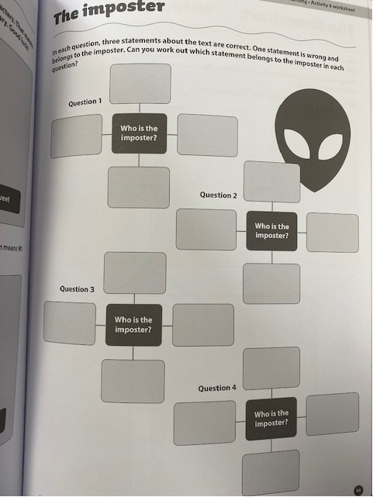
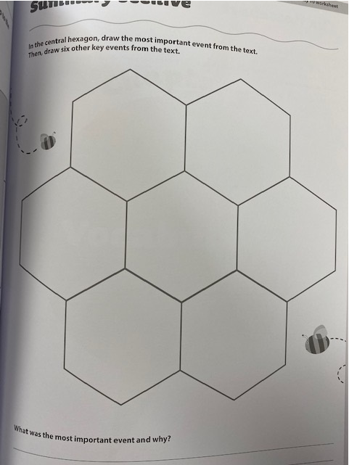

Slide 26
Reading Explaining/ Comparing

Slide 27
Partner talk
Explaining for a different audience
Debate
Conscience Corridor
Looking a short extracts by the same author – what is the same/what is different.
Odd one out.
Venn diagrams
Compare texts on a similar theme.

