Slide 1


Teaching and Learning Pocket Guide
-Retrieval Practice-

Slide 2
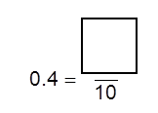




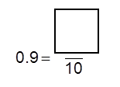





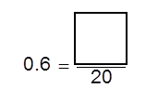
Idea 1:
Challenge Grid
What can children remember from yesterday’s lesson, how about last week or the week before?
A quick 5 minute activity to assess what knowledge is being retained.
Last Lesson
(1 point)
Last Week’s Learning
(2 points)
Learning from 2 weeks ago (3 points)
Learning from Last Year
(5 points)

Slide 3
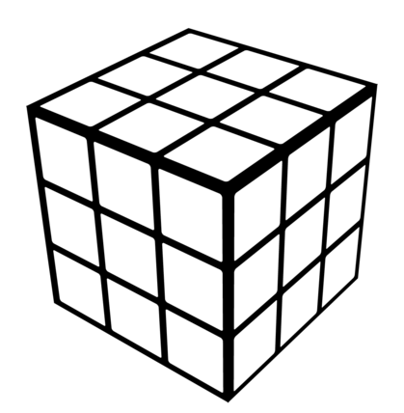
Idea 2:
Knowledge ‘Rubik’s cube’
Can the children remember key vocabulary and knowledge linked to key concepts?
Here, the children are to match the vocabulary to the concepts – this resource can easily be adapted to any area of the curriculum.
It could be used as part of a pre and post topic assessment.
Canopic jar
Isis
Hathor
3000 artefacts
Howard Carter
amulet
Lord Carnarvon
Horus
1922
expensive
by accident
Thoth
shroud
embalm
Valley of the Kings
Ra
70
days
10 years
Osiris
preserve
Dendera
Death Mask
jackal
Mummification
temple
afterlife
natron
curse
Gods and Goddesses
Discovery of Tutankhamun’s tomb

Slide 4





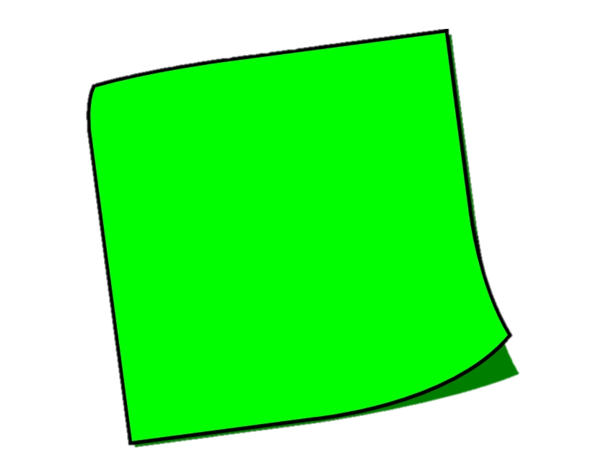


Idea 3:
Retrieval post-its
A really quick starter activity. This can easily be differentiated for the various learners in your class as not all children necessarily have to provide a response for each question – this can be targeted/ rotated etc.
You could provide the children with an individual sheet or have a piece of flipchart/sugar paper on the learning wall on which to add their responses.
What key words did you use or learn last lesson?
Explain a key piece of learning from last week in your own words?
State 3 important pieces of information from last lesson.
How does this knowledge link to topics you have learned about before?

Slide 5
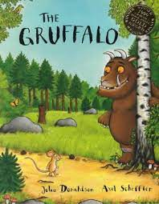

Idea 4:
Retrieve and Correct grid.
In this activity, the children will use their prior knowledge to correct a set of statements in a grid.
The mouse first meets a snake. | The owl invites the mouse around to his house for breakfast. | The author describes the Gruffalo’s eyes as red.
The snake lives in a burrow under a tree. |  | The Gruffalo’s favourite food is owl pancakes.
The author describes the Gruffalo’s teeth as terrifying. | The Gruffalo has a spot at the end of his nose. | The fox asked the mouse to go round for tea.
To challenge your more able children, they could have some statements that are a mixture of true and false or be given a blank grid to write their own statements for a partner to have a go at.

Slide 6
Idea 5:
What is the meaning?
In this activity, the children will demonstrate that they have remembered meaning of key vocabulary that has been taught.
This could be an English focus or a Curriculum focus.
Vocabulary | Definition
abdomen
absorb
digestion
dissolve
oesophagus
Challenge:
Can you use each of these words in a sentence?
You could colour code the words as a way of differentiating which words you would like different groups to focus on.

Slide 7

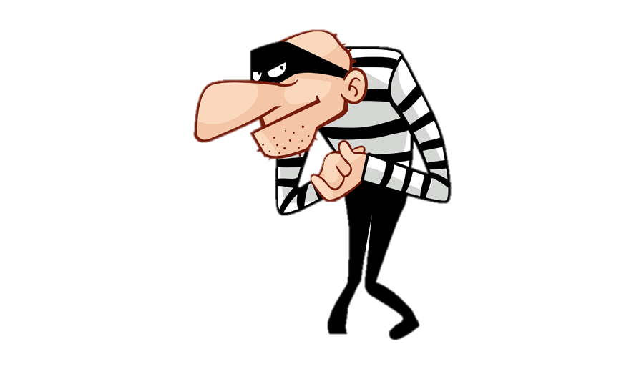
Idea 6:
Cops & Robbers
In this activity, the children will demonstrate what they have remembered about a concept – this could be a way of reviewing a lesson/ sequence of lessons or a whole topic.
What facts/ information can you remember about_____________? | What facts/ information have you ‘stolen’ from your peers?
You may want to set a minimum of points the children must remember themselves – otherwise they may just want to rob!

Slide 8
Idea 7:
Retrieval Relay
In this activity, the children work in teams.
The team has to recall as much knowledge about a lesson or topic as possible.
No ideas can be repeated!
What effect did the Romans leaving have on Britain?
2 minutes: Your knowledge
2 minutes: Your neighbour’s knowledge
2 minutes: Your neighbour’s knowledge
2 minutes: Your neighbour’s knowledge
You could award prizes, house points or dojos to the team with the most facts remembered. You could repeat the activity a week later to see what has been retained.

Slide 9
Idea 8:
Walkabout Bingo
In this activity, the children have to walk around the classroom and ask peers a question from their Bingo board.
Each child can only answer one question for one other pupil – therefore the same child cannot be asked lots of times!
What was mummification? A: Name: | Were all ancient Egyptians mummified? A: Name:
Who was the god of mummification? A: Name: | What was the name used for the people who carried out mummifications? A: Name:
What were some of the internal organs placed in when they were taken out of the body? A: Name: | How long did the process of mummification take in total? A: Name:

Slide 10
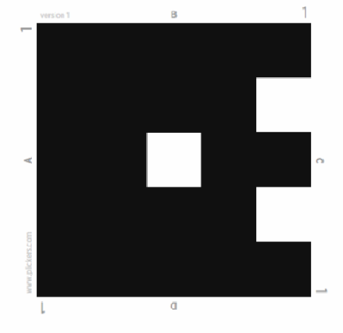
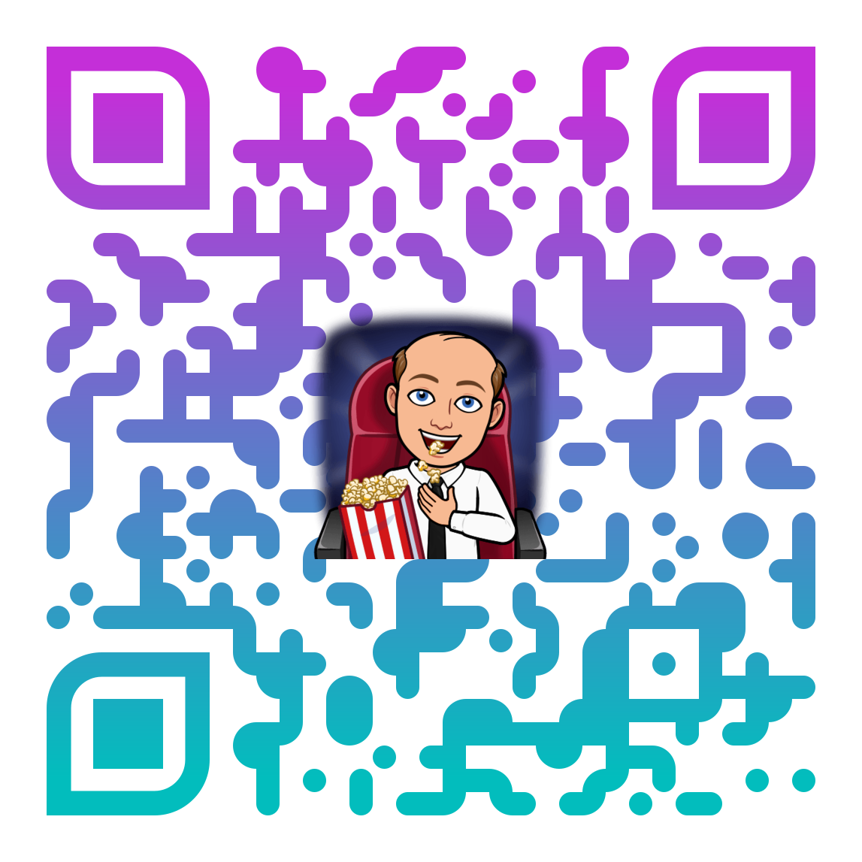
Idea 9:
Plickers
In this activity, we make use of technology to find our what the children know/ have remembered about a topic. https://get.plickers.com/
After creating a free account, you can add your class.
You will then be able to create your own quizzes and download plickers cards.
Look on the website to find out how to use this resource.
Scan me
Each Plicker card works like a QR code and is unique – therefore children cannot copy from one another.

Slide 11
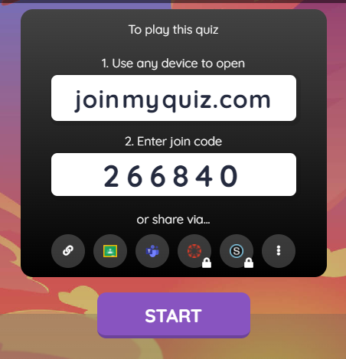
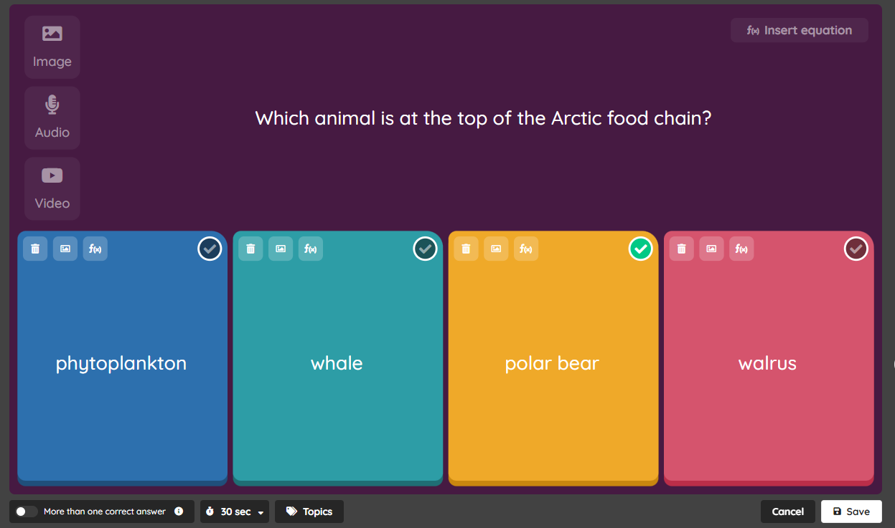
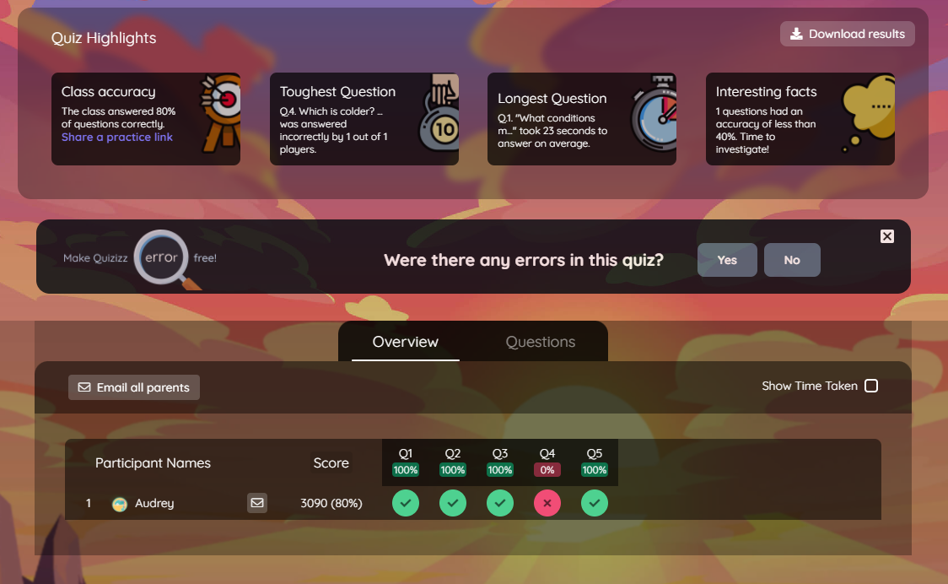
Idea 10:
Quizizz
Similar to Kahoot, Quizlet and Mentimeter, this is an online platform for generating quizzes. Two benefits of Quizziz over others is that the teleport feature allows the user to browse through other quizzes and pick and choose questions they would like to put in to their own. Quizziz scores the quizzes for children and gives instant feedback plus the teacher can analyse results without having to input class lists during set up. Quizzes can be imported from spreadsheets.

